Slide 1


Decoding the payroll challenge

Slide 2


25⁺
¹⁰⁰⁺
years of experience in craft
Million Users
15000⁺
14
ABOUT
Employees
Data centers
3
150⁺
divisions
55⁺
Countries
Products
Notes:
We need to validate the numbers before publishing it live and request the sales team to keep this updated.

Slide 3



Timeline of the Zoho HR Suite
Notes:
Remove collaboration tools

Slide 4
Topics
Existing landscape
Prevalent challenges
Statistics
Meet Zoho Payroll
An overview
What makes Zoho Payroll different
How are businesses using Zoho Payroll
Most loved features
Customer success stories
Brands that love us

Slide 5



The existing landscape
What customers are using
What customers want
Notes:
Notes to Sathya: Refer to the document on how to structure this slide.

Slide 6
What customers are using
What customers want
Paper-based systems
Automatic payroll
Time-consuming
Inaccurate
Difficult to maintain
Time-saving automation throughout the payroll cycle
Notes:
Notes to Sathya: Refer to the document on how to structure this slide.

Slide 7
What customers are using
What customers want
Spreadsheets
Flexible system
Missing cell values
Broken formulas
Multiple spreadsheets for data storage
to accommodate growing business needs
Notes:
Notes to Sathya: Refer to the document on how to structure this slide.

Slide 8
What customers are using
What customers want
Multi-vendor, outsourced systems
Transparent communication with one vendor
Lack of ownership
Difficult to coordinate
Notes:
Notes to Sathya: Refer to the document on how to structure this slide.

Slide 9
What customers are using
What customers want
In-house but outdated systems
Reduce or eliminate inter-department dependencies
Big effort for small changes
Dependence on IT department
Notes:
Notes to Sathya: Refer to the document on how to structure this slide.

Slide 10
What customers are using
What customers want
In-house but disparate systems
Unified data model
Duplicate data entry between HR and payroll teams
Multiple systems to track data
seamless transition between systems
Notes:
Notes to Sathya: Refer to the document on how to structure this slide.

Slide 11
What customers are using
What customers want
Slow transition to cloud
Flexible, cloud-based systems
Notes:
Notes to Sathya: Refer to the document on how to structure this slide.

Slide 12
GPA survey numbers agree
60%
20,000
300 Crore
use manual payroll
payroll regulation changes within one year
penalty for non-remittance of PF, TDS
60%
45%
feel multiple vendor coordination is hard
felt disparity between HR, Payroll and Accounting
Sources: Global Payroll Association - The Power of Payroll white paper Global Payroll Association survey white paper 2019
Notes:
The statistics are detailed by the global payroll provider SD Worx, in their research report titled "An investigation into the accuracy of payroll". The pitch should focus on explaining how it is a challenge here in India as well and quote some of the examples from India, like the PF or TDS penalties for late payments. Slide alignment needs to change.

Slide 13
Meet
Cloud-based payroll software crafted for businesses of all sizes

Slide 14





Zoho Payroll overview
Clutter-free, fresh UI with minimal learning curve
Compliance by design
Features focused on getting payroll done faster
Comprehensive and insightful payroll reports
Native iPhone and Android apps for self-service

Slide 15
What makes Zoho Payroll standout?

Slide 16

Continuous innovation
Betting big on technology
Real-time employer employee collaboration
Digitization of routine tasks
Contextual hand-holding

Slide 17
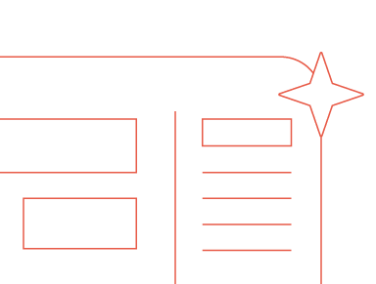
Modern user experience
Futuristic UI
Unambiguous clarity
Uncluttered data management
Consistent aesthetics

Slide 18

Privacy-first approach
Dedicated servers in India
Multi-factor authentication
Password-protected self-service
Custom user roles & permissions
Data backup
Notes:
Add the privacy badges from our website footer.

Slide 19

Democratizing payroll technology
FREE payroll software for businesses with less than 10 employees

Slide 20
Cross-functional collaboration
Zoho Payroll and Zoho People
Zoho Payroll and Zoho Books
Automatic employee profile synchronization
Contextual employee directory updates
Up-to-the-minute employee attendance
Integrated LOP data
Automated journal entries
Payroll transaction reconciliation
Customisable chart of accounts

Slide 21
Elevating employee experience:
Going where your employees are
Download payslips, TDS worksheets, and Form-16
Receive notifications for proof submission deadlines and updates
Ask clarifying questions in real-time to payroll admins
Claim reimbursements and attach receipts
Submit IT declarations and Proof of Investments
Track loans and repayment summary

Slide 22
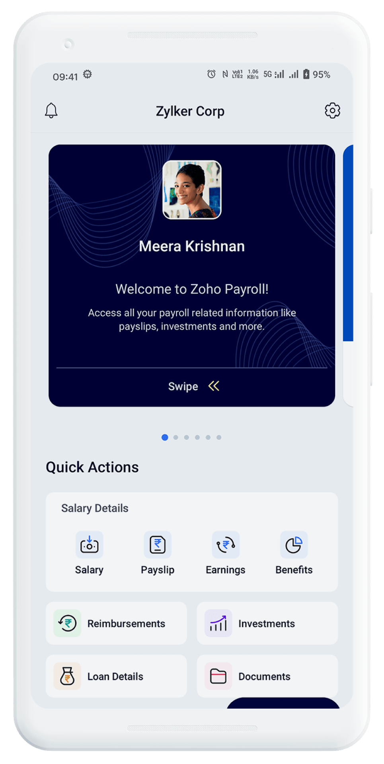
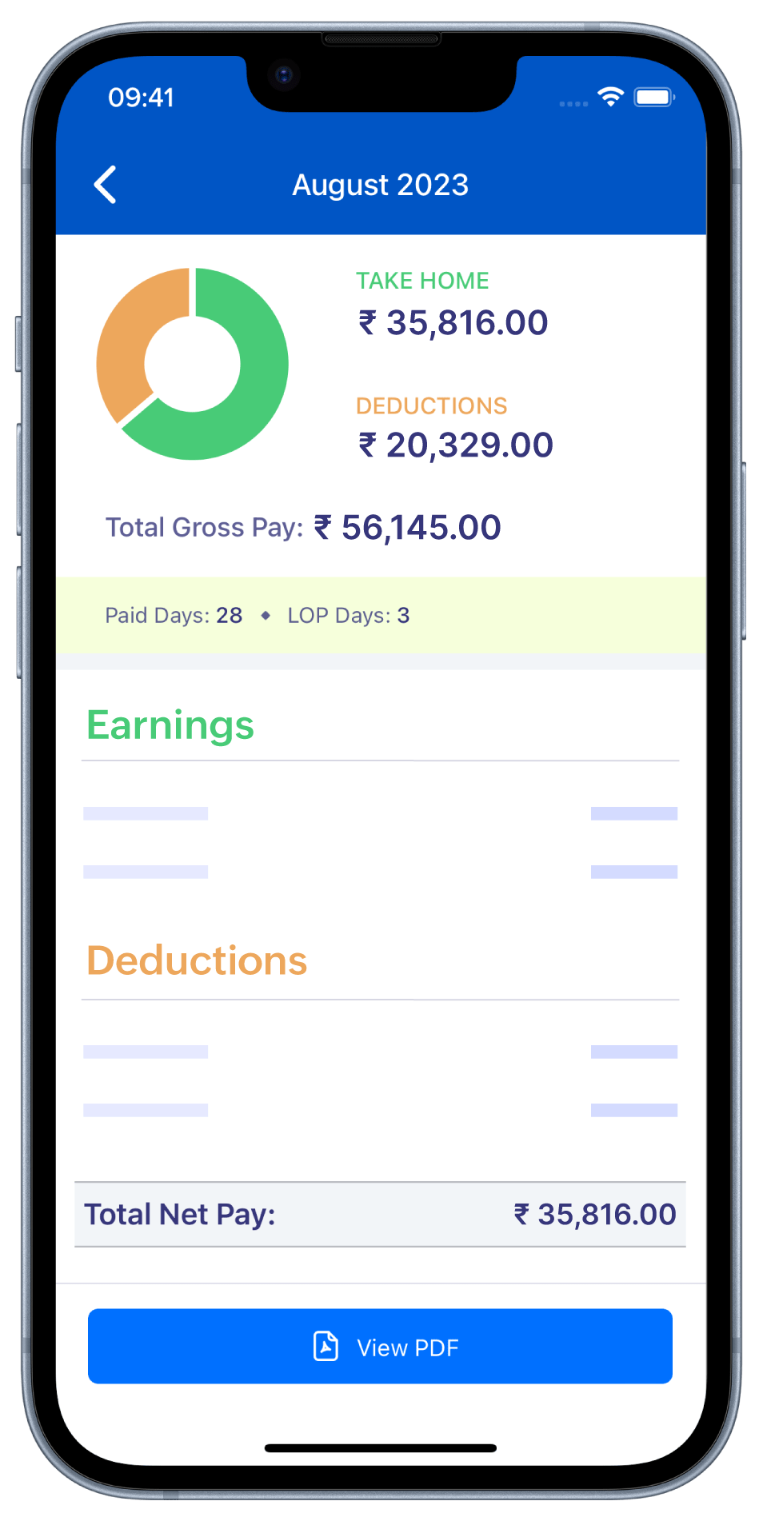



Bringing mobility to payroll
So employees can access their payroll information from wherever they are.

Slide 23

Breaking conventions with Bank integrations
Direct Deposit
YES Bank and HSBC Integration
100% success record for salary payments
Auto-generated bank statements
Auto-verification of IFSC code
Selective payments

Slide 24
How businesses are using Zoho Payroll

Slide 25

Customizing payroll to their org policies
Multiple work-locations
Statutory configurations (PF, ESI, PT, LWF)
Organization pay schedule
Organized proof collection for (FBP, Reimbursements, IT Declaration, and POI)
Notes:
The sub-points here aren't needed. Fresh

Slide 26
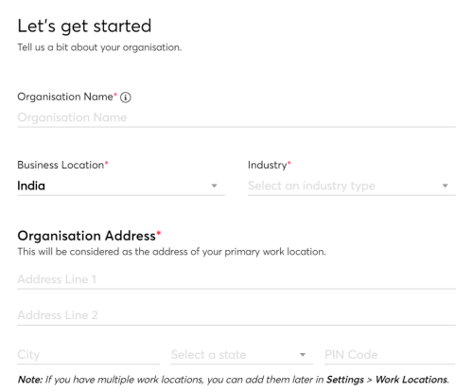
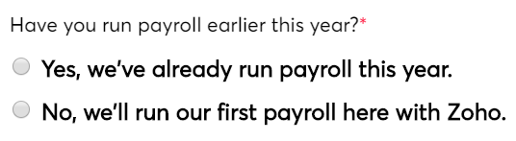
Setup
Organization Setup
Work Locations
Tax Information
Pay Schedule
Statutory Components
Salary Components

Slide 27
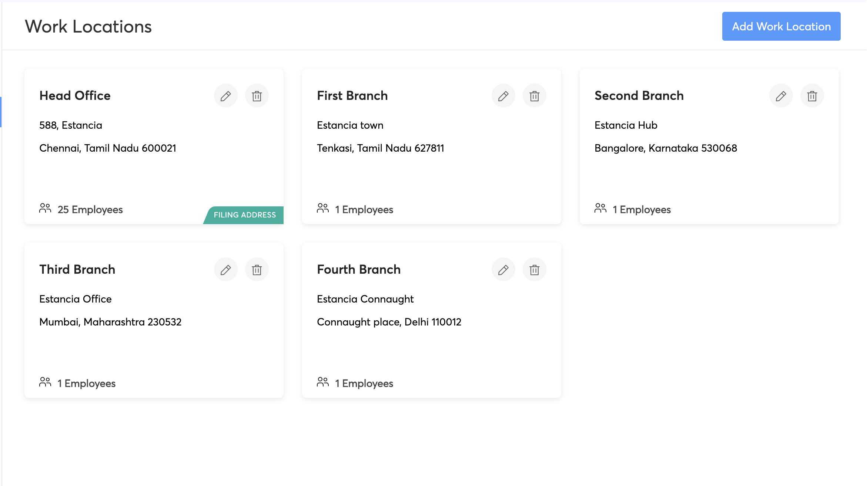
Setup
Organization Setup
Work Locations
Tax Information
Pay Schedule
Statutory Components
Salary Components

Slide 28
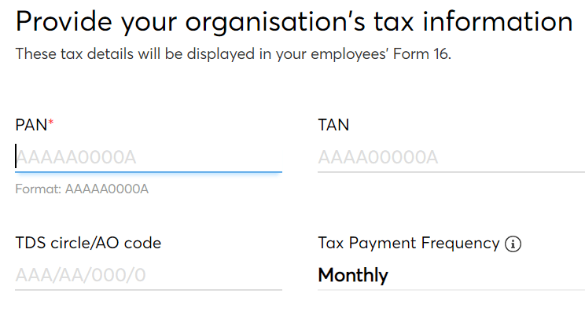
Setup
Organization Setup
Work Locations
Tax Information
Pay Schedule
Statutory Components
Salary Components
Note: AO code can be got from the IT office or online IT account

Slide 29
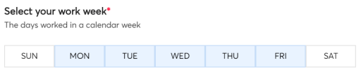
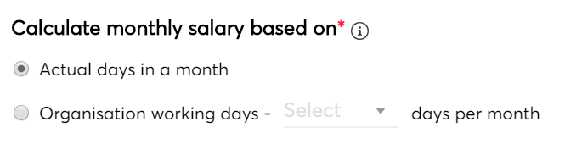
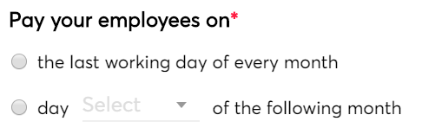
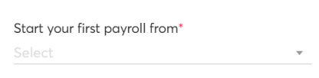
Setup
Organization Setup
Work Locations
Tax Information
Pay Schedule
Statutory Components
Salary Components

Slide 30
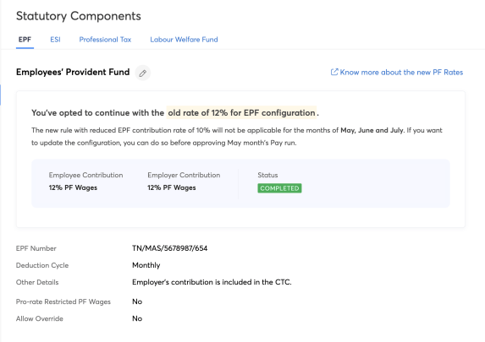
Setup
Organization Setup
Work Locations
Tax Information
Pay Schedule
Statutory Components
Salary Components
ESI
PT
LWF
Notes:
Sathya: This slide is from a previous presentation that we did. I am not sure if we need those circles below. However, you check once.

Slide 31
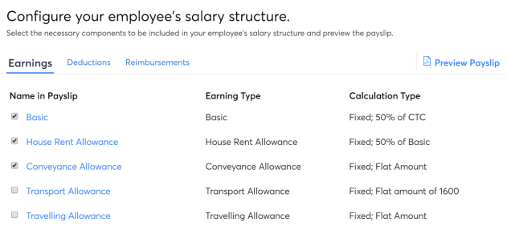
Setup
Organization Setup
Work Locations
Tax Information
Pay Schedule
Statutory Components
Salary Components

Slide 32

Simplifying onboarding
Adding employees
Import
Auto-sync
Templated salary structure

Slide 33
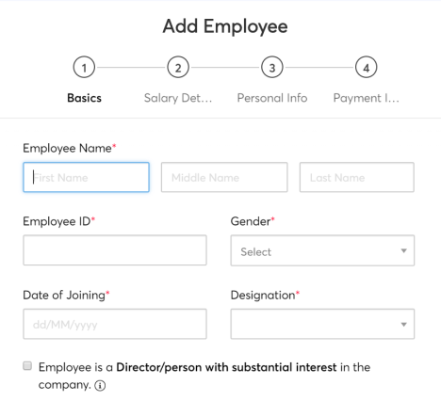
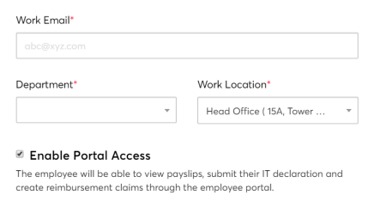
Onboarding
Basic Details
Add Employees
Bulk-Import
Auto Sync
Salary Templates
Previous Payroll Data

Slide 34
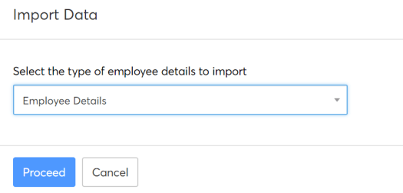
Onboarding
Add Employees
Bulk-Import
Auto Sync
Salary Templates
Previous Payroll Data

Slide 35
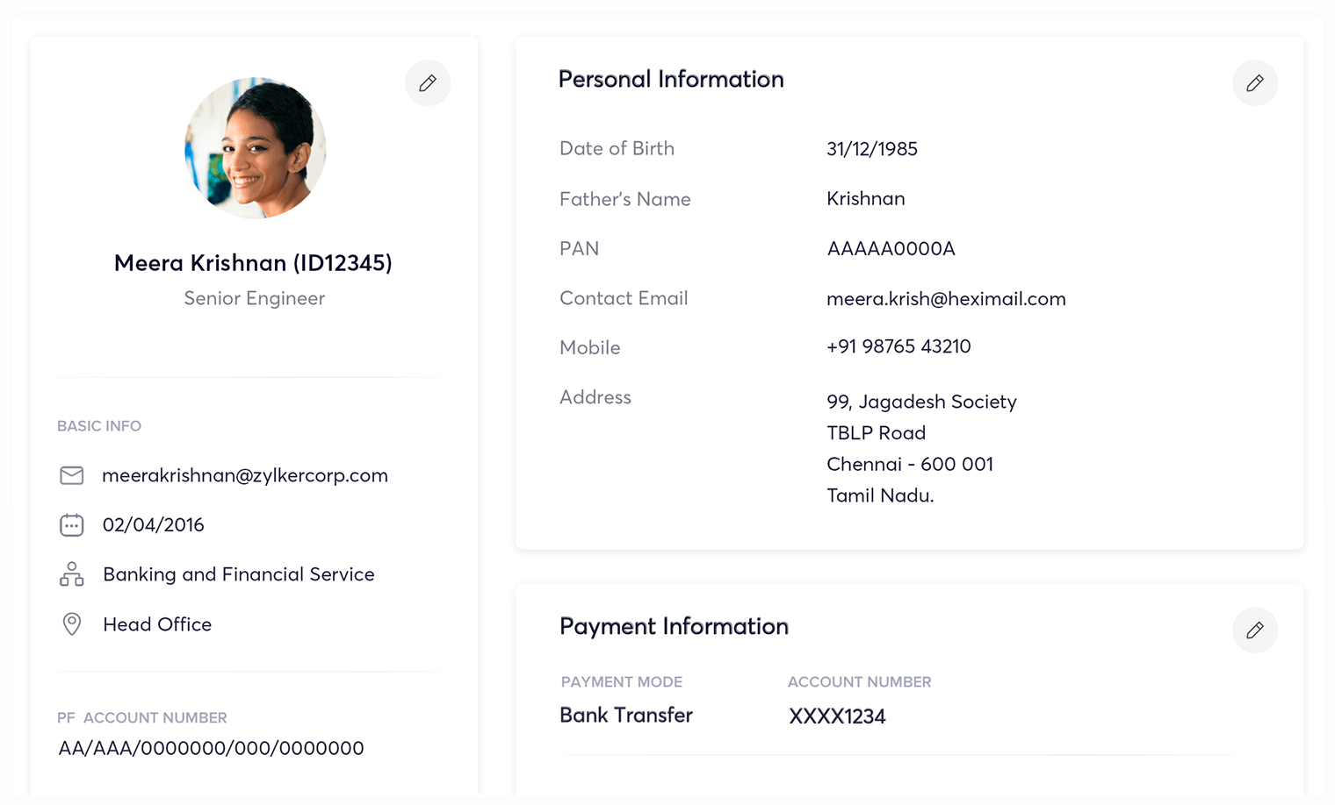
Onboarding
Add Employees
Bulk-Import
Auto Sync
Salary Templates
Previous Payroll Data
Notes:
Note for Satthya: Payroll Icon needs to be updated.

Slide 36
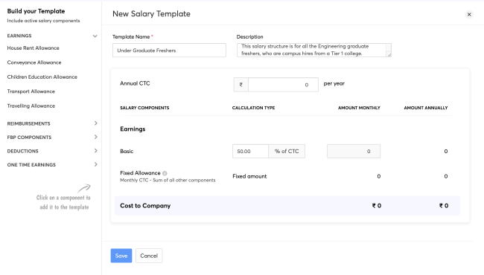
Onboarding
Add Employees
Bulk-Import
Auto Sync
Salary Templates
Previous Payroll Data

Slide 37
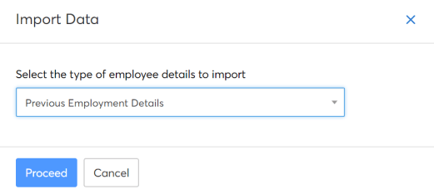
Onboarding
Add Employees
Bulk-Import
Auto Sync
Salary Templates
Previous Payroll Data

Slide 38
Design compensations for everyone
Custom allowance components
Non-taxable reimbursements
Correction components for earnings and deductions
Pre-tax or post-tax deduction components

Slide 39
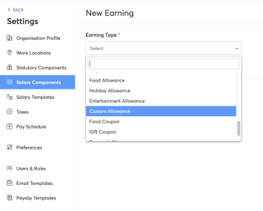
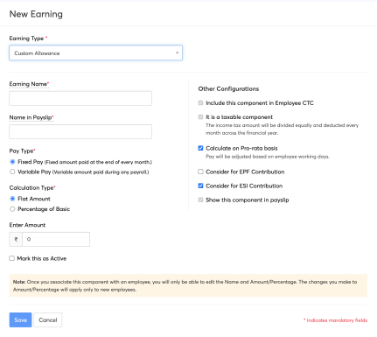
Custom components

Slide 40
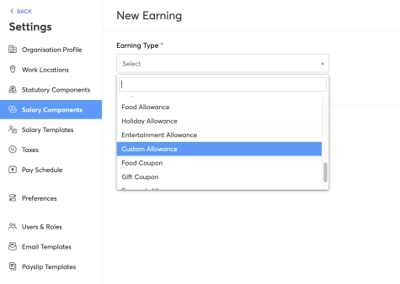
Correction components

Slide 41
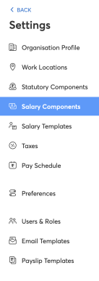
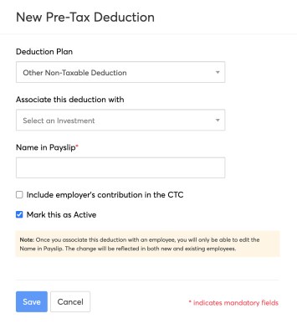
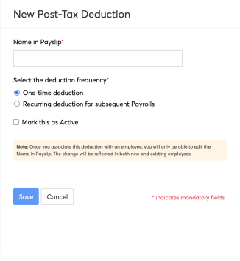
Pre & Post Tax Deductions

Slide 42

Controlled Administration
Controlled payroll governance with role-based access
Modifying pay days after the first pay run
Automatic tracking of loans and advances
Collecting Proof of Investments in multiple phases

Slide 43
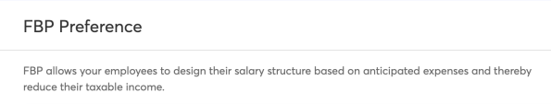
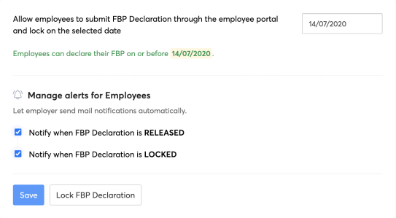
Employees
Admin
Functions
Flexible Benefit Plan
Reimbursement Claims
IT Declaration
Proof of Investments
Users & Roles
Loan Management
Termination

Slide 44
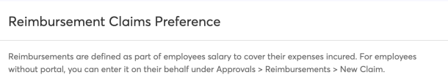
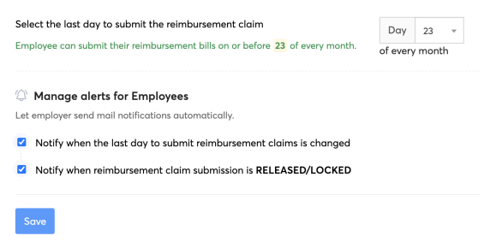
Admin
Functions
Flexible Benefit Plan
Reimbursement Claims
IT Declaration
Proof of Investments
Users & Roles
Loan Management
Termination

Slide 45
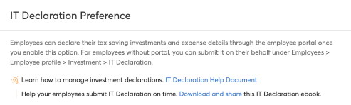
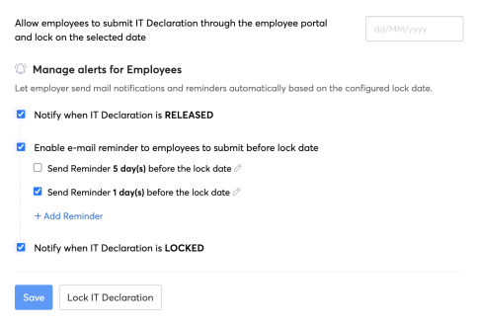
Admin
Functions
Flexible Benefit Plan
Reimbursement Claims
IT Declaration
Proof of Investments
Users & Roles
Loan Management
Termination

Slide 46
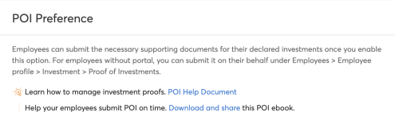
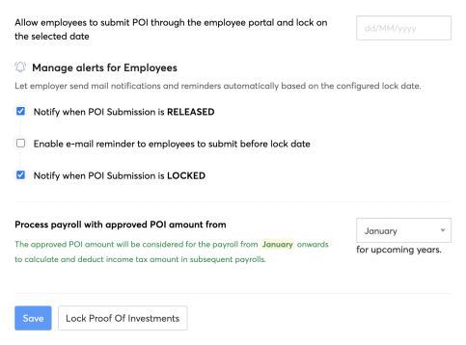
Admin
Functions
Flexible Benefit Plan
Reimbursement Claims
IT Declaration
Proof of Investments
Users & Roles
Loan Management
Termination

Slide 47
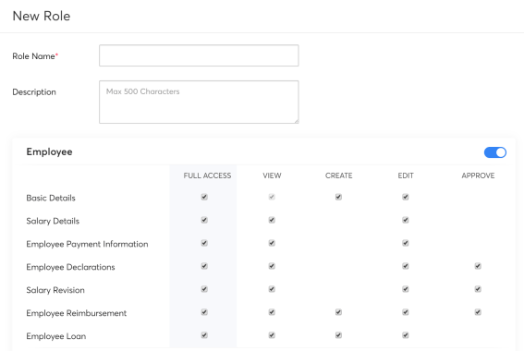
Admin
Functions
Flexible Benefit Plan
Reimbursement Claims
IT Declaration
Proof of Investments
Users & Roles
Loan Management
Termination

Slide 48
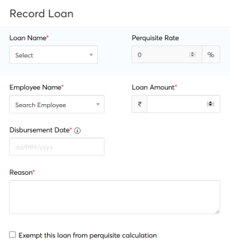
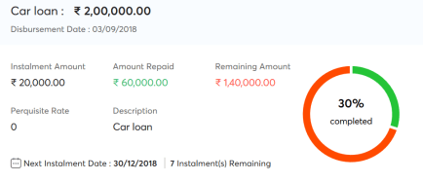
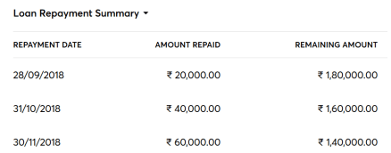
Admin
Functions
Flexible Benefit Plan
Reimbursement Claims
IT Declaration
Proof of Investments
Users & Roles
Loan Management
Termination

Slide 49
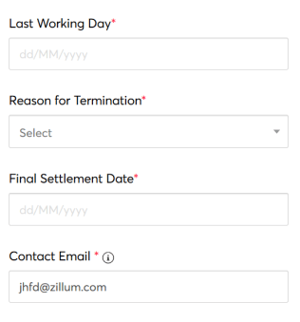
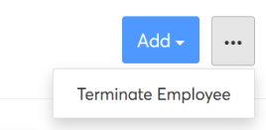
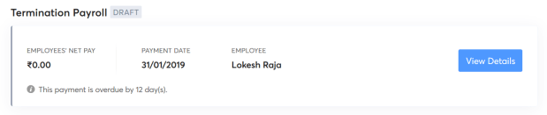
Admin
Functions
Flexible Benefit Plan
Reimbursement Claims
IT Declaration
Proof of Investments
Users & Roles
Loan Management
Termination

Slide 50

Effortless payroll runs
Editing Payroll
Add Inputs
Single-click leave and attendance sync
Preview of payslips and TDS worksheets

Slide 51
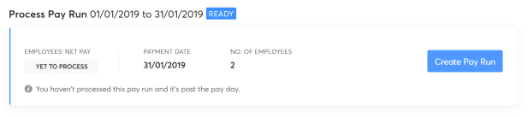
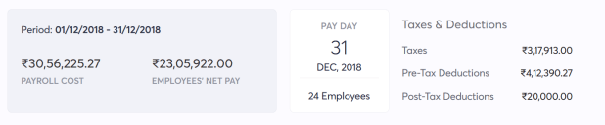
Employees
Processing
Editing pay runs
Add inputs
Single-click LOP
Make payments
Rejecting pay runs

Slide 52

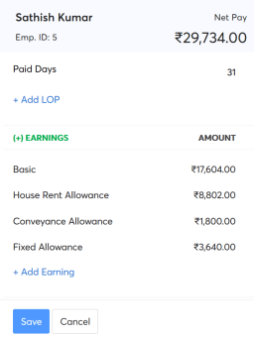
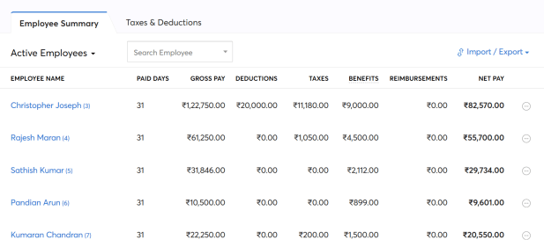

Processing
Editing pay runs
Add inputs
Single-click LOP
Make payments
Rejecting pay runs

Slide 53
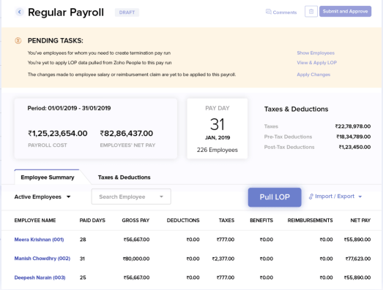
Processing
Editing pay runs
Add inputs
Single-click LOP
Make payments
Rejecting pay runs

Slide 54
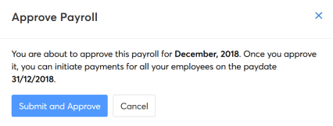
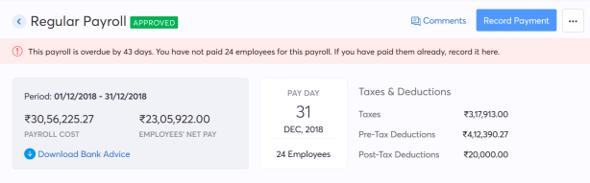
Processing
Editing pay runs
Add inputs
Single-click LOP
Make payments
Rejecting pay runs

Slide 55


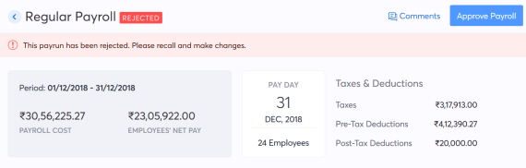
Processing
Editing pay runs
Add inputs
Single-click LOP
Make payments
Rejecting pay runs

Slide 56

Post Payroll
Password-protected forms
Payslips, Tax-worksheets, and Form-16
Distribution through email and self-service portals

Slide 57
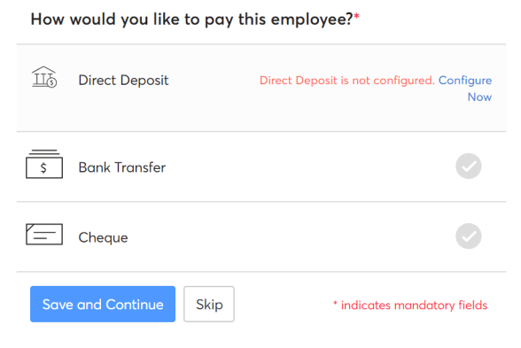
Completion
Salary payments
Automatic payslips
Tax worksheets
Payroll forms
Accounting
Reporting
Summary
Notes:
Notes for Sathya: The same tick mark has to reflect near the Direct Deposit option as well.

Slide 58
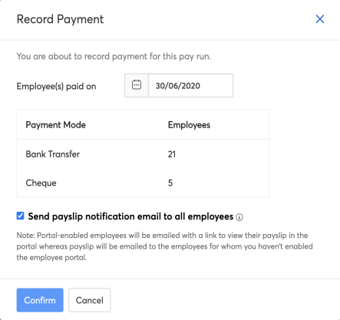
Completion
Salary payments
Automatic payslips
Tax worksheets
Payroll forms
Accounting
Reporting
Summary

Slide 59

Completion
Salary payments
Automatic payslips
Tax worksheets
Payroll forms
Accounting
Reporting
Summary

Slide 60

Completion
Salary payments
Automatic payslips
Tax worksheets
Payroll forms
Accounting
Reporting
Summary

Slide 61

Completion
Salary payments
Automatic payslips
Tax worksheets
Payroll forms
Accounting
Reporting
Summary

Slide 62

Completion
Salary payments
Automatic payslips
Tax worksheets
Payroll forms
Accounting
Reporting
Summary

Slide 63

Completion
Salary payments
Automatic payslips
Tax worksheets
Payroll forms
Accounting
Reporting
Summary
Notes:
Name near "Welcome", needs to be changed. We can have Christopher or some other name. Active employees: Count needs to be increased. Check if we can reuse the same screenshot that we've used for the homepage. Arun should be having that file.

Slide 64
Payroll success stories

Slide 65

"Zoho Payroll was a natural fit. With useful integrations and swift support team, it has been able to resolve our biggest payroll issues on a single platform. It is very comprehensive and easy to use. Zoho Payroll has helped cut down our costs and TAT's making payrun completion a great experience for us !"
Leegality
Payroll run time
5 times faster
Implementation time
Less than two week
Digitization benefits
Saved 42 hours/month

Slide 66

"I have been a Zoho Payroll user since it was launched. The moment I got the feel of the product's UI, I had no second thoughts. It is a simple solution that can take care of itself and did not require our conscious effort. The attentive support team helped us get onboarded in just a week and then there was no turning back. It's been over a year now and we are happy to have chosen Zoho Payroll for our HR operations."
Purple slate
Payroll run time
3 times faster
Implementation time
Less than a week
Digitization benefits
Saved 40 hours/month

Slide 67











Great brands that love us

Slide 68
What else

Slide 69



Support, Onboarding, Free-trial
Instant, customer-friendly support
Onboarding consultation
30-day free trial

Slide 70


The Zoho Finance Ecosystem
Notes:
Circular like Invoice

Slide 71

Questions?

Slide 72
Thank You

